Slide 1
Comprehensive Digital Marketing Project Work

Slide 2
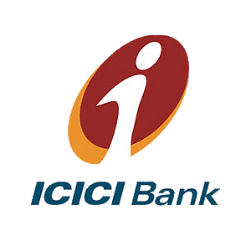
Part 1: Brand study, Competitor Analysis & Buyer’s/Audience’s Persona
COMPANY/TOPIC for project: ICICI Bank
Research Brand Identity: Study the brand's mission, values, vision, and unique selling propositions (USPs).
Brand Colours:
Orange, White
Logo:
Mission/Values:
Vision: To be the leading provider of financial services in India and a major global bank. Mission: ICICI will leverage our people, technology, speed and financial capital to: be the banker of the first choice for our customers by delivering high quality, world-class products, and services.
USP:
ICICI is the most efficient and tech Savvy bank in the Indian banking industry

Slide 3
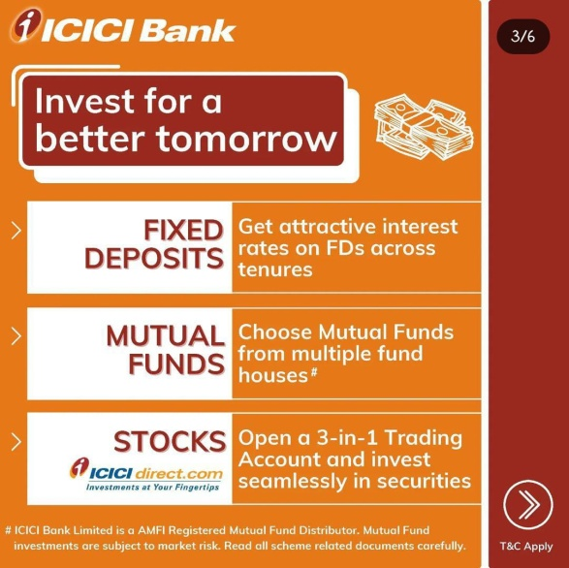
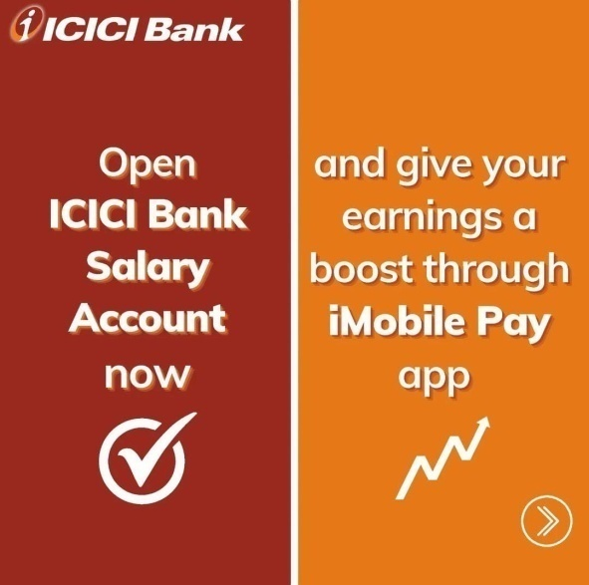
Part 1: Brand study, Competitor Analysis & Buyer’s/Audience’s Persona
COMPANY/TOPIC for project: ICICI Bank
Analyze Brand Messaging:
Fun & Informative, Awareness Posts about Frauds, Tutorials of Net Banking
eg:-
https://www.instagram.com/p/Cr-UC7wgORg/?igshid=MzRlODBiNWFlZA==
Examine the brand's tagline:
‘Khayaal Apka”

Slide 4
Part 1: Brand study, Competitor Analysis & Buyer’s/Audience’s Persona
Competitor Analysis: Select three competitors operating in the same industry or niche as the chosen brand, examine their USPs and online communication.
Competitor 1: HDFC BANK
https://www.hdfcbank.com/
USP-
HDFC is one of the big four banks in India
ONLINE COMMUNICATION:-
Provided Ask EVA chat box for personal assistant to help us with related queries, Chat on Whatsapp service, User generated content
Competitor 2: AXIS BANK
https://www.axisbank.com/
USP-
Customer-Centric Approach, Innovative Digital Banking, Product and Service Portfolio
ONLINE COMMUNICATION:-
Provided Ask AHA chat bot, Awareness through instagram, Police Department endorsements

Slide 5
Competitor 3: PAISA BAZAAR
https://www.paisabazaar.com/
USP-
One-stop financial marketplace, Extensive product offerings, User-friendly interface
ONLINE COMMUNICATION:-
We can even reach out to them via WhatsApp, Relatable content through memes,

Slide 6
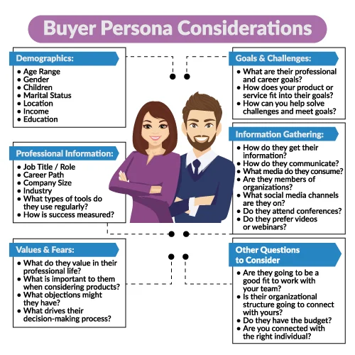
Part 1: Brand study, Competitor Analysis & Buyer’s/Audience’s Persona
Buyer's/Audience's Persona: Clearly define the target audience for the chosen brand. Consider demographics, psychographics, behaviors, and interests.
AGE RANGE- Above 10 years ( Includes minor accounts), It also providing ICICI Bank Young tar Account between the age of 1-18 years
GENDER- Any Gender
CHILDREN- Yes (ICICI Bank Young tar Account)
MARITAL STATUS- Married/Unmarried
LOCATION- Metro Cities, Tier 2 & Tier 3 Cities
INCOME- >2,00,000
EDUCATION- Educated/Non Educated
WHAT DO THEY VALUE IN THEIR PROFESSIONAL LIFE? – Social Status, May lead better life
WHAT IS IMPORTANT TO THEM WHEN CONSIDERING PRODUCTS?-Rate of Interest, Handling Charges, Hidden charges, Comparisions, Card Benefits
WHAT OBJECTIONS MIGHT THEY HAVE?- Hidden Charges, Heavy interests
HOW DO THEY GET THEIR INFORMATION?- SMS, Phone Calls, Internet Banking Notifications, Ads on websites
HOW DO THEY COMMUNICATE?- Whatsapp, Chat bot, Instagram, E-mail,
SMS, Toll free numbers etc

Slide 7
Part 2: SEO & Keyword Research
SEO Audit: Do an SEO audit of the brands website
Keyword Research: Define Research Objectives, Brainstorm Seed Keywords, Utilize Keyword Research Tools (SEMrush or Moz Keyword Explorer),Analyze Competitor Keywords, Long-tail Keyword Exploration (specific, longer phrases) that align with the research objectives and have lower competition but higher conversion potential.
On page Optimization: Meta Tag optimization & content optimization
Reflect on the process of conducting keyword research and the SEO recommendations provided.
Document the challenges faced during the research and analysis phase, as well as the key insights gained from the keyword research process.

Slide 8
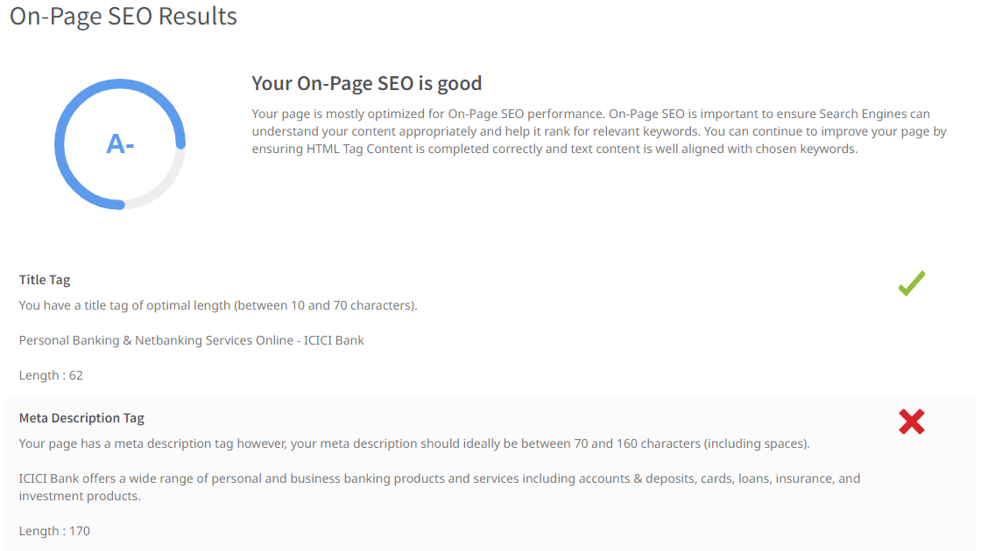
SEO Audit: Do an SEO audit of the brands website

Slide 9
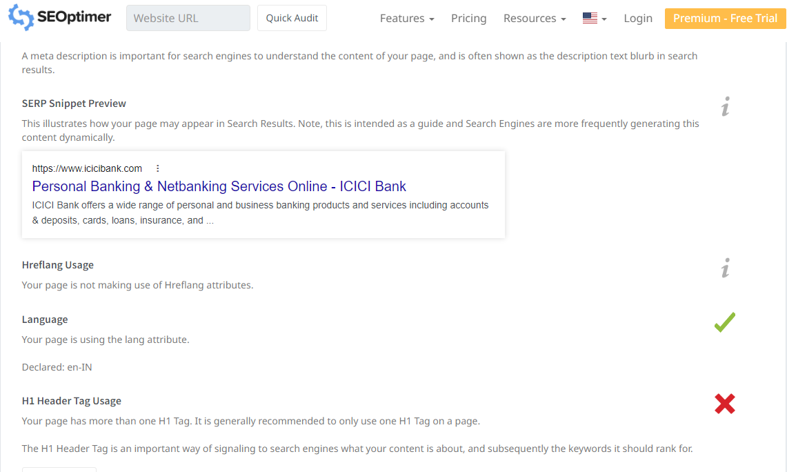

Slide 10
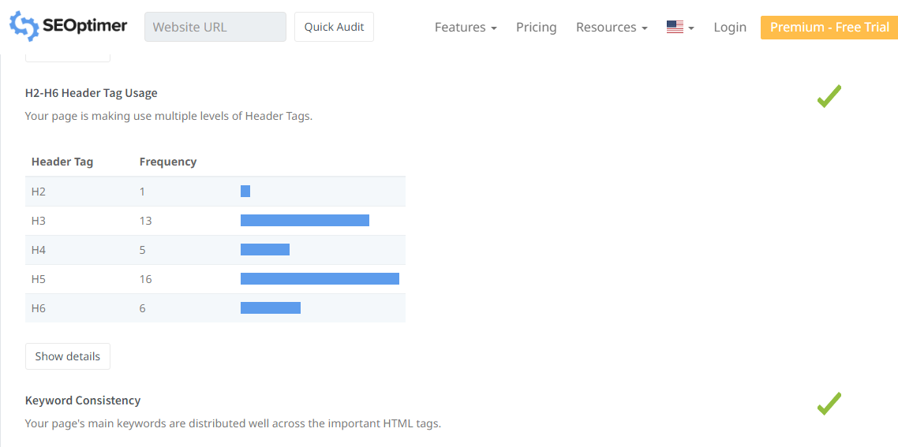

Slide 11
LOANS
Keyword | Avg. monthly searches | Competition
car loan | 50000 | Low
educational loan | 50000 | Low
mudra loan | 500000 | Low
Meta Title
FInd the best loans like Car ,Educational & Mudra loans at ICICI Bank |  |  | 69
Meta Description
Apply now for the feautured loans like Car loan, Educational loan, Mudra loan at ICICI Bank |  |  | 91
LOAN RATES
Keyword | Avg. monthly searches | Competition
car loan rates | 5000 | Low
home loan rates | 5000 | Low
personal loan rates | 5000 | Low
Meta Title
Check the lowest loan rates of Car loan,Home loan,Personal loan |  |  | 63
Meta Description
Apply for lowest rates of Car loan, Home loan, Personal loan at ICICI Bank |  |  | 74
Notes:
11

Slide 12
CHARGES
Keyword | Avg. monthly searches | Competition
credit card charges | 5000 | Low
debit card transaction charges | 500 | Low
credit card swipe charges | 5000 | Low
Meta Title
Check the charges of Credit card,debit card & credit card swipe charges |  |  | 71
Meta Description
Apply feautured Loans like Home loan, Mudra Loan, Student Loan from HDFC |  |  | 72
EMI
Keyword | Avg. monthly searches | Competition
gold emi online | 50 | High
gold emi scheme | 500 | Low
gold loan emi | 500 | Medium
Meta Title
Explore new options like gold emi online,gold emi scheme,gold loan emi |  |  |  | 70
Meta Description
Check the interesting gold emi online, gold emi scheme,gold loan emi at ICICI Bank |  |  |  | 82

Slide 13
CREDIT CARDS
Keyword | Avg. monthly searches | Competition
postpaid credit card | 500 | Medium
fixed deposit credit card | 5000 | Medium
fuel credit card | 5000 | Medium
Meta Title
We introducing new postpaid,fixed deposit,fuel Credit cards in our Bank |  |  | 71
Meta Description
Enjoy the benifits of new feautured Credit cards like Postpaid, Fixed deposit, Fuel credit cards in our Bank |  |  |  |  |  | 108

Slide 14
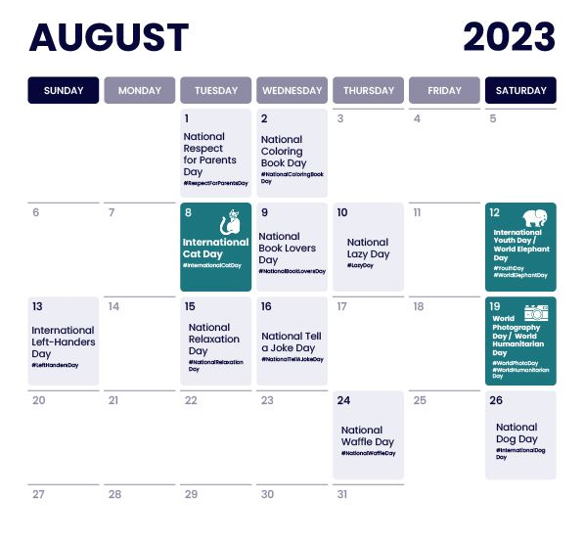
Part 3: Content Ideas and Marketing Strategies
Content Idea Generation & Strategy: Create a content calendar for the remaining month of July by brainstorming content themes, exploring various formats like blog posts, videos, infographics, podcasts, and interactive quizzes, and scheduling publication dates mainly on Facebook & Instagram.
And include the strategy, aim and the idea behind these posts and story
Content Calendar Example (Try creating a table for the month of July)

Slide 15

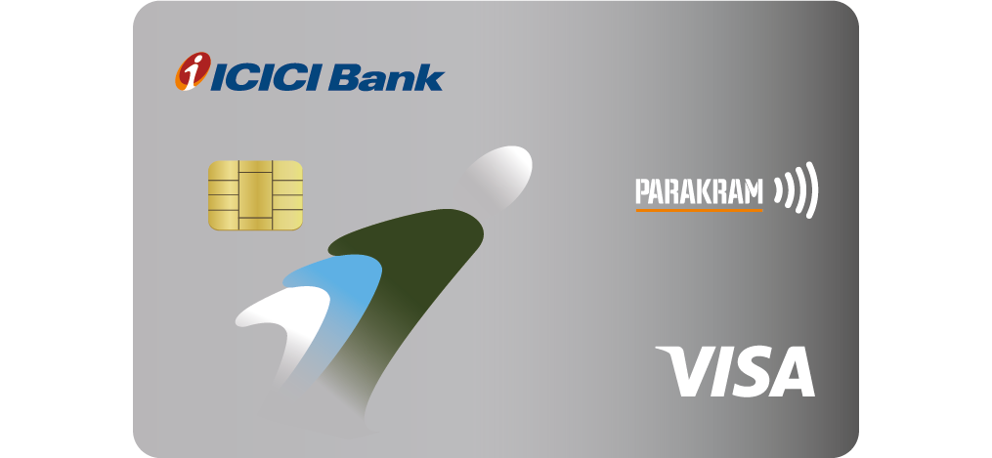
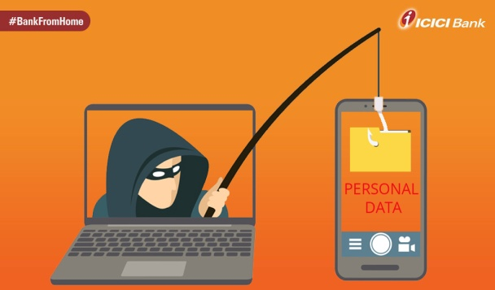
Part 3: Content Ideas and Marketing Strategies
Reflect on the content ideas and marketing strategies process, discussing the challenges encountered and lessons learned.
Date : 3rd August
To Provide Info & Knowledge on a ICICI Bank Digital Marketing services
ICIC Bank allows to apply personal loan at online for customers. This blog will cover the details of how to apply for personal loan at your finger tips
Date : 4th August
To promote Information & Knowledge on a ICICI Parakram Credit Cards
ICICI Introduced new ICICI Parakram Credit Card & Visualise the Benefits & Features of this Card
Date : 5th August
Awareness on Frauds
To create a meme on Awareness about frauds of SMS links

Slide 16
Creating content ideas and devising effective marketing strategies is a dynamic process that involves continuous learning and adaptation. Throughout this journey, several challenges and valuable lessons can be encountered. 1.Understanding the Audience: One of the primary challenges is comprehending the target audience's preferences, needs, and pain points. 2. Generating Unique Ideas: Coming up with fresh and innovative content ideas can be difficult, especially in saturated markets. 3. Consistency and Quality: Maintaining a consistent flow of high-quality content can be demanding. Setting up an editorial calendar and adhering to a content creation schedule helps in maintaining quality and meeting deadlines. 4. Content Promotion: Even the best content may not gain traction without proper promotion. Crafting effective marketing strategies to reach the target audience across various channels is crucial for success. 5. Collaboration: Collaborating with influencers or other brands can amplify the reach of content and strengthen marketing efforts. The content ideas and marketing strategies process is an iterative and learning-oriented journey

Slide 17
Part 4: Content Creation and Curation (Post creations, Designs/Video Editing, Ad Campaigns over Social Media and Email Ideation and Creation)
Post Creation:
Select Content Categories: Identify three different content formats relevant to the chosen topic or industry. Research and Brainstorm: Research trending topics, industry news, or audience interests within each category. Brainstorm ideas for social media posts that align with each category. Do note that 1 content format has to be video and additionally 3 stories/status are to be created.
Format 1 : Blog Article
Format 2 : Video
Format 3 : Creative

Slide 18
Part 4: Content Creation and Curation (Post creations, Designs/Video Editing, Ad Campaigns over Social Media and Email Ideation and Creation)
Format 1 : Blog Article
Aim : To Provide Info & Knowledge on a ICICI Bank Digital Marketing services
Date : 3rd August
Idea : ICIC Bank allows to apply personal loan at online for customers. This blog will cover the details of how to apply for personal loan at your finger tips
Topic : Here are the typical steps to apply for an ICICI Bank personal loan online:
Go to the ICICI Bank official website (www.icicibank.com)
Explore Loan Products: Browse through the various loan products and select "Personal Loan" to view the details
Check Eligibility: Before applying, check the eligibility criteria for the personal loan. This may include factors such as age, income, employment status, credit score, etc.
Use the Online Eligibility Calculator: ICICI Bank usually provides an online eligibility calculator where you can input your income, existing EMIs, and other details to get an estimate of the loan amount you might be eligible for.
Online Application: If you meet the eligibility criteria and are comfortable with the loan terms, you can proceed with the online application. Look for the "Apply Now" or "Apply Online" button on the personal loan page.
Fill out the Application Form: Complete the online application form with accurate and up-to-date information. You will need to provide details such as your name, contact information, employment details, income, and other relevant personal data.

Slide 19
Upload Documents: You'll likely need to submit some supporting documents to verify your identity, income, and address. These documents may include:
KYC documents (e.g., Aadhar card, passport, voter ID, etc.)
Proof of residence (e.g., utility bills, rental agreement)
Salary slips or income proof
Bank statements
Agree to Terms and Conditions: Read through the loan terms and conditions carefully. If you agree with them, provide your consent.
Submit Application: Double-check all the details you've entered and make sure your documents are attached correctly. Once everything is in order, submit the application.
Wait for Approval: After submitting your application, ICICI Bank will review your application and documents. If you meet their criteria, you should receive a confirmation of approval.
Loan Disbursal: Once approved, the loan amount will be disbursed to your bank account, which you provided during the application process.

Slide 20

Part 4: Content Creation and Curation (Post creations, Designs/Video Editing, Ad Campaigns over Social Media and Email Ideation and Creation)
Format 2 : Video
Aim : To promote Information & Knowledge on a ICICI Parakram Credit Cards
Date : 4th August
Idea : ICICI Introduced new ICICI Parakram Credit Card & Visualise the Benefits & Features of this Card
Topic : ICICI Parakram Select & Parakram Credit Cards

Slide 21
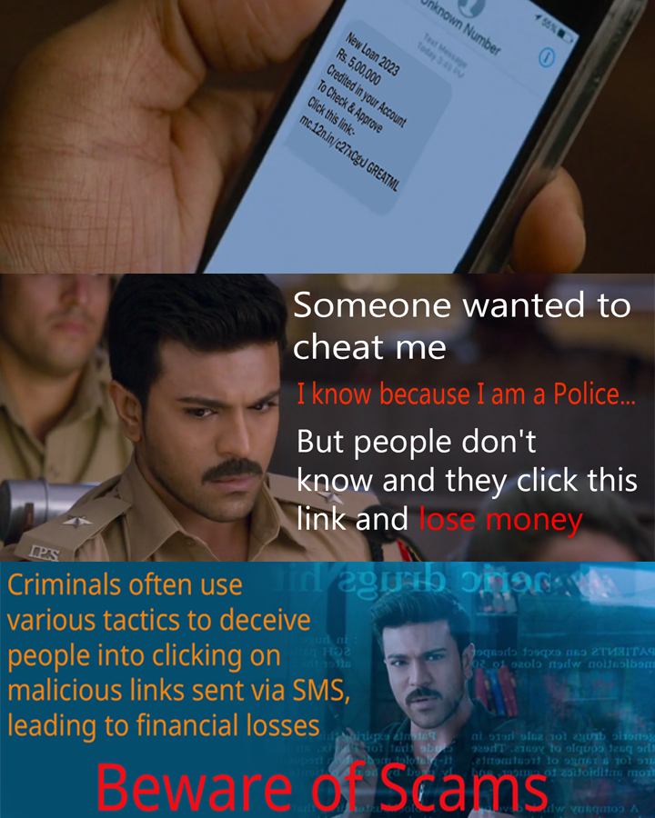

Part 4: Content Creation and Curation (Post creations, Designs/Video Editing, Ad Campaigns over Social Media and Email Ideation and Creation)
Format 3 : Creative
Aim : Awareness on Frauds
Date : 5th August
Idea : To create a meme on Awareness about
frauds through SMS links
Topic : Beware of Scams
Notes:
21

Slide 22
Part 4: Content Creation and Curation (Post creations, Designs/Video Editing, Ad Campaigns over Social Media and Email Ideation and Creation)
Instagram Story
Utilize the Stories feature on Instagram for three consecutive days. Share behind-the-scenes glimpses, polls, quizzes, or sneak peeks etc to encourage audience participation. Once uploaded use the story highlight feature on Instagram and save the 3 story with an appropriate name for each.
Note:
Once done monitor the performance of the posts and Stories using the insight tool and analyze the engagement metrics (likes, comments, shares, impressions, etc.). Based on the analysis, mention the strategies and areas for improvement.

Slide 23
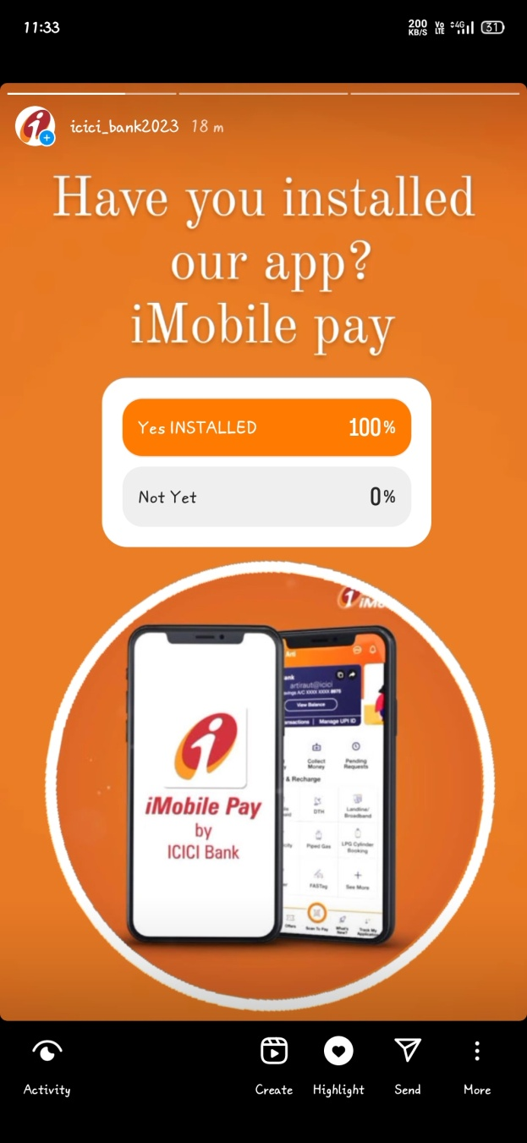
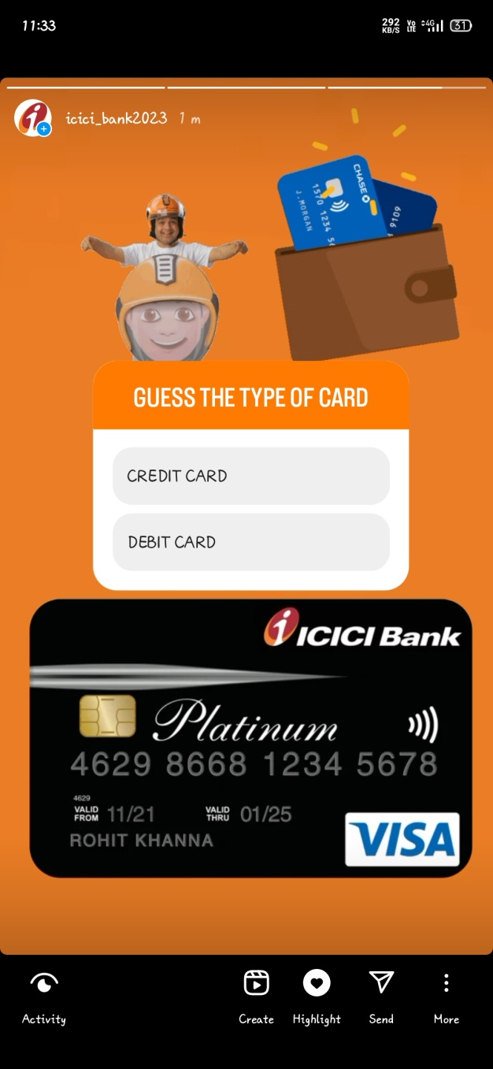
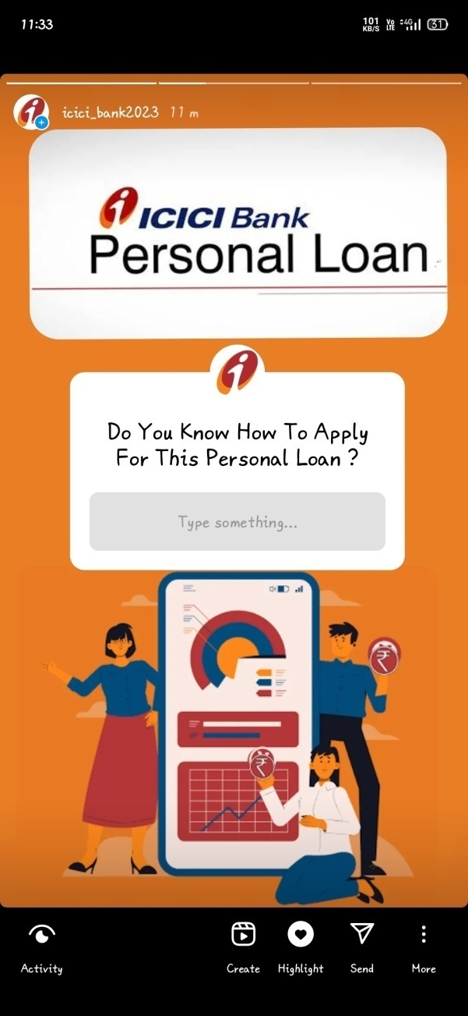
Part 4: Content Creation and Curation (Post creations, Designs/Video Editing, Ad Campaigns over Social Media and Email Ideation and Creation)
Instagram Story

Slide 24
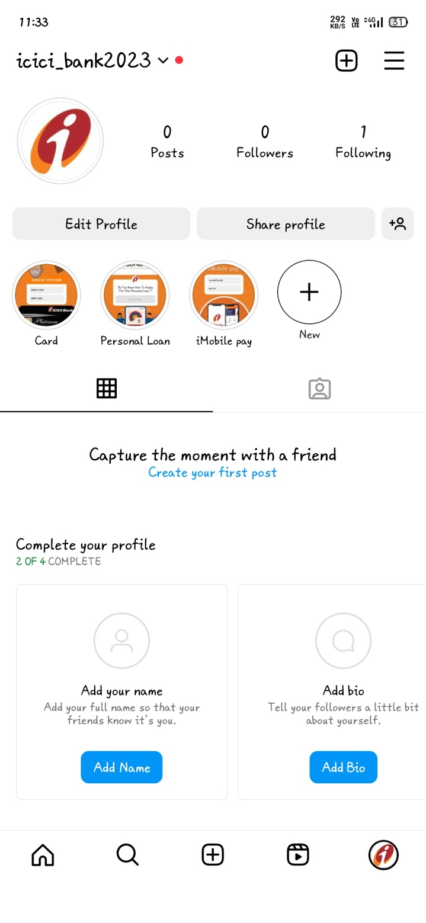

Slide 25
Part 4: Content Creation and Curation (Post creations, Designs/Video Editing, Ad Campaigns over Social Media and Email Ideation and Creation)
Designs/Video Editing
Design Tools Familiarization (use Canva for creating visually appealing graphics)
Video Creation: Utilize VN or any video editor of your choice to create videos related to the chosen topic.

Slide 26
Part 4: Content Creation and Curation (Post creations, Designs/Video Editing, Ad Campaigns over Social Media and Email Ideation and Creation)
Social Media Ad Campaigns
Ad Campaigns over Social Media:
Come up with 3 ad campaigns each covering one of the mentioned goals: brand awareness, driving website traffic, or generating leads

Slide 27
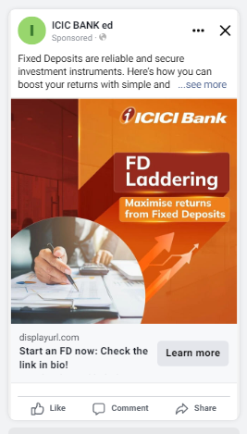
Part 4: Content Creation and Curation (Post creations, Designs/Video Editing, Ad Campaigns over Social Media and Email Ideation and Creation)
Social Media Ad Campaigns
BRAND AWARENESS CAMPAIGN:-
Targeting- Location: India, All Genders
Interests: Axis Bank, HDFC Bank, Yes Bank, IndusInd Bank

Slide 28
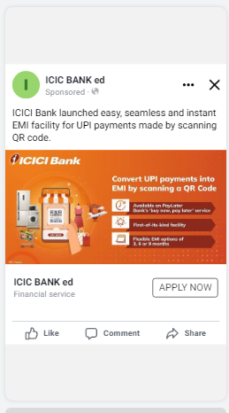
Part 4: Content Creation and Curation (Post creations, Designs/Video Editing, Ad Campaigns over Social Media and Email Ideation and Creation)
Social Media Ad Campaigns
DRIVING WEBSITE TRAFFIC :-
Targeting- Location: India, All Genders
Interests: Axis Bank, HDFC Bank, Yes Bank, IndusInd Bank

Slide 29
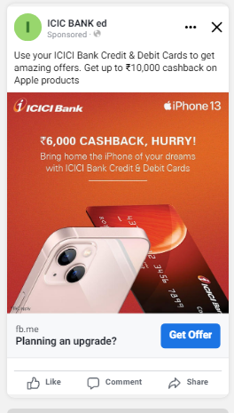
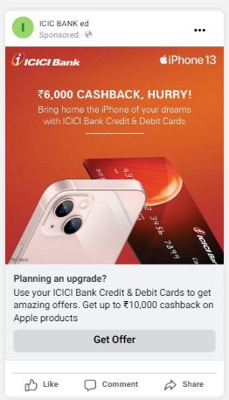
Part 4: Content Creation and Curation (Post creations, Designs/Video Editing, Ad Campaigns over Social Media and Email Ideation and Creation)
Social Media Ad Campaigns
GENERATING LEADS :-
Targeting- Location: India, All Genders
Interests: Axis Bank, HDFC Bank, Yes Bank, IndusInd Bank

Slide 30
Part 4: Content Creation and Curation (Post creations, Designs/Video Editing, Ad Campaigns over Social Media and Email Ideation and Creation)
For every campaign clearly define:
Advertising Goals: increasing brand awareness, driving website traffic, or generating leads.
Audience Targeting: Define the target audience for the ad campaigns based on demographics, interests, and behavior.
Ad Creation: Create visually appealing ad creatives, compelling ad copy and relevant call-to-action.

Slide 31
Part 4: Content Creation and Curation (Post creations, Designs/Video Editing, Ad Campaigns over Social Media and Email Ideation and Creation)
Email Ad Campaigns
Ad Campaigns for email marketing:
Come up with 2 email ad campaigns with the mentioned goals: brand awareness & generating leads

Slide 32
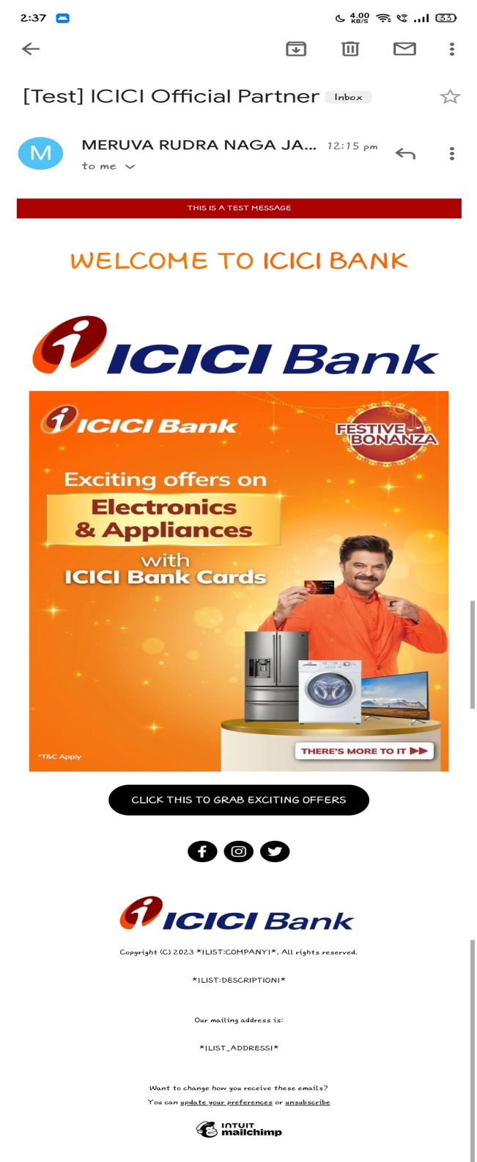
Email Ad Campaign 1 - Brand Awareness (insert emailer image)

Slide 33
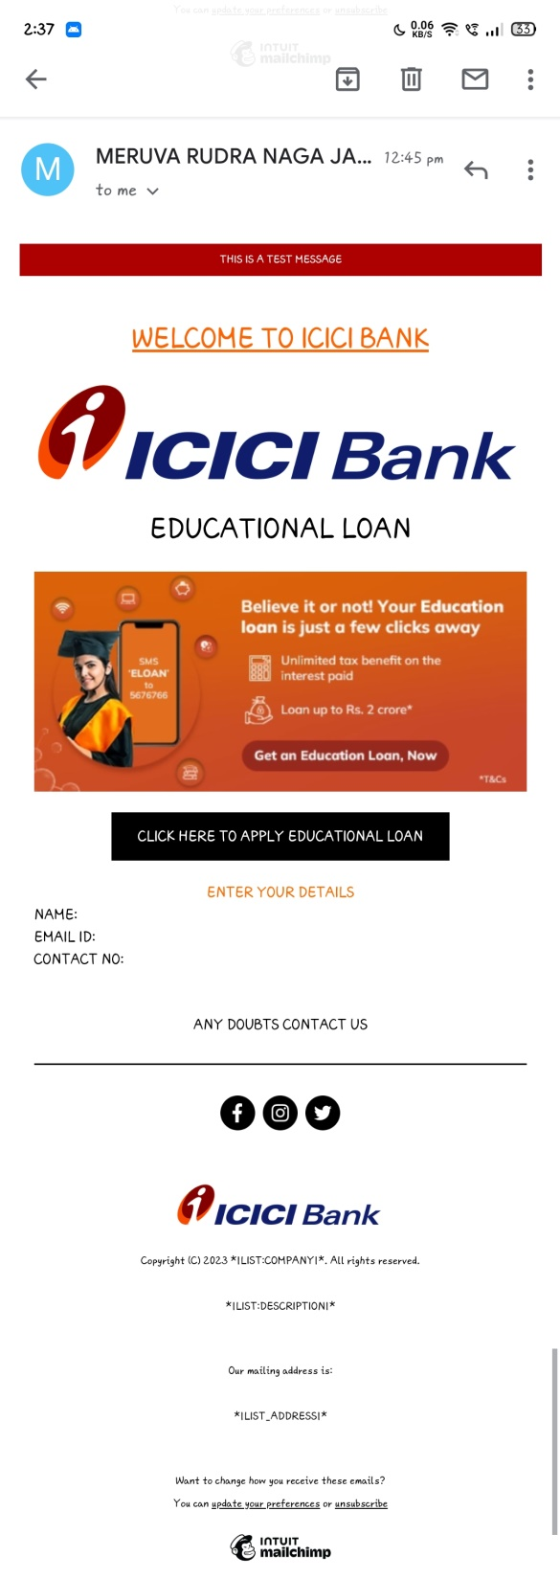
Email Ad Campaign 2 - Lead Generation (insert emailer image)

Slide 34
Part 4: Content Creation and Curation (Post creations, Designs/Video Editing, Ad Campaigns over Social Media and Email Ideation and Creation)
Reflect on the content creation and curation process, discussing the challenges faced and lessons learned.
1. Consistency is Key: Maintaining a consistent tone, style, and frequency of content across platforms helps reinforce brand identity and improves audience recall.
2.Visual Appeal: Eye-catching visuals, well-designed graphics, and professionally edited videos can significantly enhance the impact of content and ad campaigns.
3. A/B Testing: Regularly conducting A/B + tests for ad campaigns and email subject lines allows for data-driven optimization and better results.
4.Know our Audience: Understanding the target audience's interests, pain points, and preferences is fundamental in creating relevant and engaging content.
5. Engage with the Audience: Responding to comments, messages, and feedback from the audience fosters a sense of community and builds trust.
6. Long-Term Approach: Content creation and marketing are not one-time endeavors. A long-term, strategic approach is necessary to build brand awareness and achieve sustainable growth.
In conclusion, content creation and curation, along with thoughtful design, video editing, and well-executed ad campaigns, play a pivotal role in a successful marketing strategy. By understanding the challenges and incorporating the lessons learned, businesses can create compelling content that resonates with their target audience and drives results

